Slide 1

Hack Western 4 Participator
Bringing transparency and accountability to the classroom

Slide 2
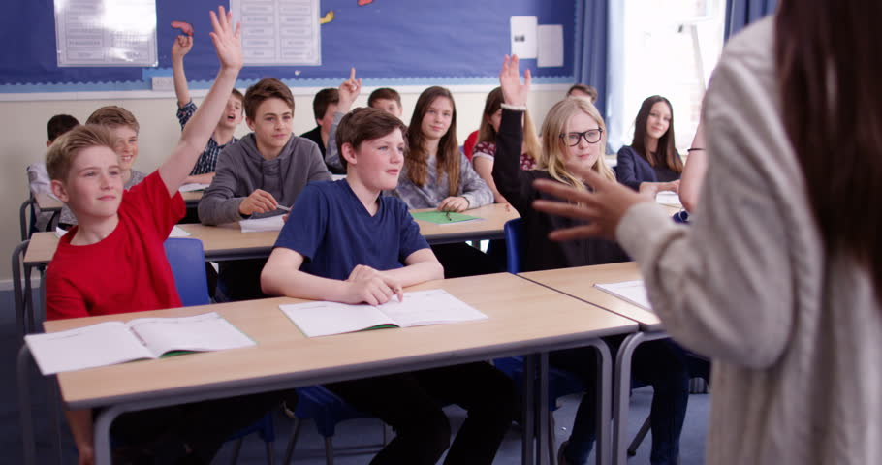
Students Aren’t Speaking In Participation Based Classes
Poor Seat Choice
Lack of Confidence
Ineffective Teaching Styles
Key insight: Not being chosen causes students to disengage in class, knowing that if they do not talk they might as well have not raised their hand.
How It Works
What’s Next
Inspiration
Results
Notes:
https://www.quora.com/How-many-blockchain-developers-are-there-in-the-world-in-2016
https://www.coinbase.com/dashboard
https://blockchain.info/charts/miners-revenue

Slide 3

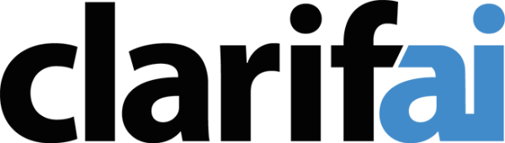
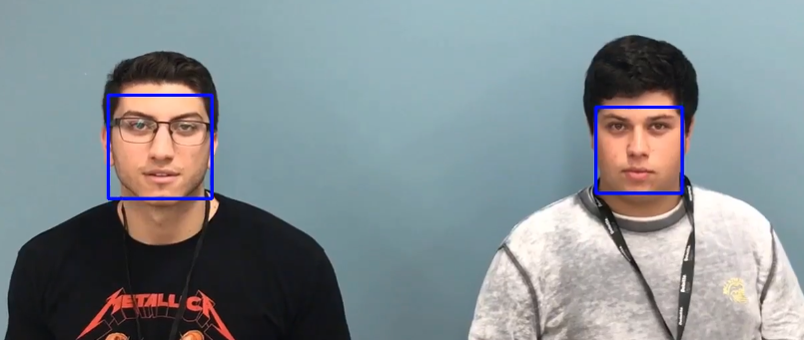
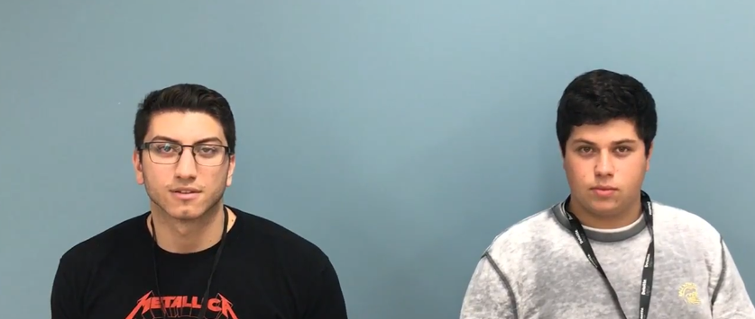
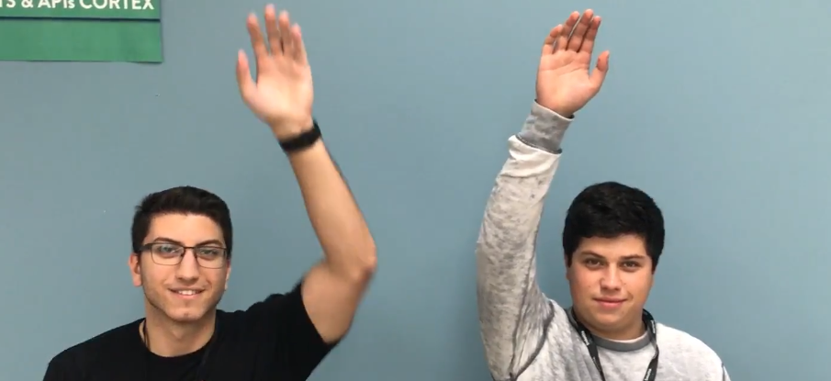
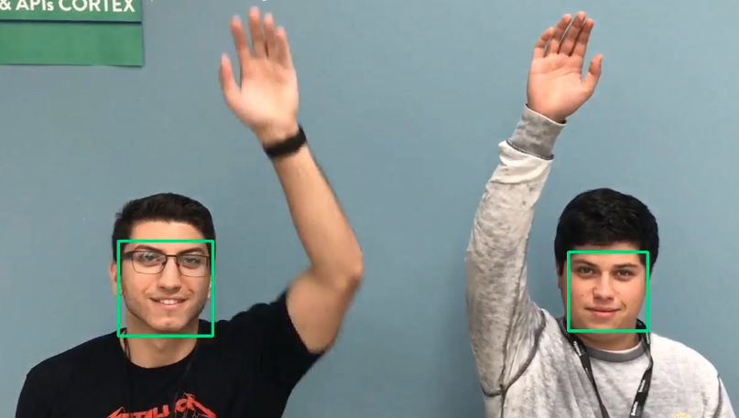
Our Development Tactics
Key insight: Our mix of facial recognition, neural networks and graphing produces flawless participation recognition in a video and individual graphs
How It Works
What’s Next
Inspiration
Results
Notes:
https://www.quora.com/How-many-blockchain-developers-are-there-in-the-world-in-2016
https://www.coinbase.com/dashboard
https://blockchain.info/charts/miners-revenue

Slide 4
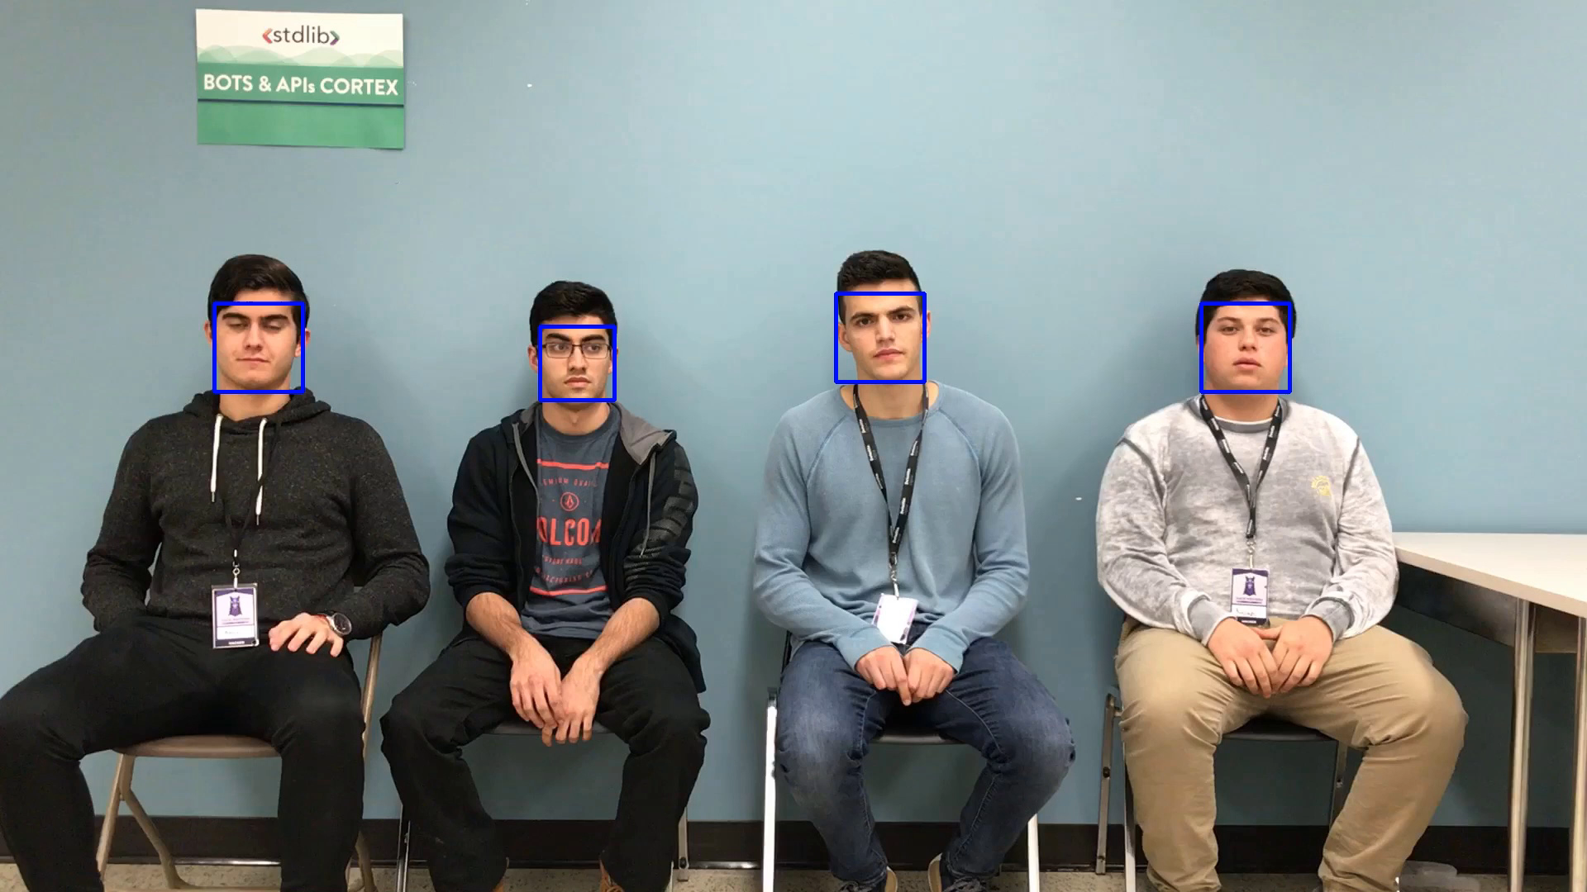
Our Results
Key insight: Our system can create videos and graphs describing when students have their hands up
Results
What’s Next
Inspiration
How It Works
Notes:
https://www.quora.com/How-many-blockchain-developers-are-there-in-the-world-in-2016
https://www.coinbase.com/dashboard
https://blockchain.info/charts/miners-revenue

Slide 5
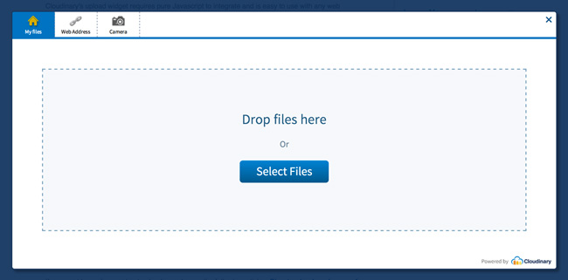
What’s Next
Create a Front End
Create Graphs Dynamically
Key insight: Our system will create videos and graphs describing when students have their hands up
What’s Next
Inspiration
Results
How It Works
Notes:
https://www.quora.com/How-many-blockchain-developers-are-there-in-the-world-in-2016
https://www.coinbase.com/dashboard
https://blockchain.info/charts/miners-revenue

Slide 6
Hack Western 4 Participator
Bringing transparency and accountability to the classroom

